Slide 1
Non-Restoring division
Presented by:
Roshan Saud

Slide 2
Non-Restoring division
The Non-Restoring Division Algorithm is a method used to perform division operations on signed integers without relying on restoring intermediate remainders. It's an iterative approach that approximates the quotient and updates the remainder in each iteration, leading to an accurate division result.

Slide 3
Non-Restroing Division(Algorithm)
Step 1: If the sign of A is 0(+ve), shift A and Q left one bit position and subtract divisor from A (A← A-B) otherwise, shift A and Q left and add divisor to A (A← A+B).
Step 2: Repeat steps 1 and 2 for n times.
Step 3: If the sign of A is 1(-ve), add divisor to A(restore A) otherwise do nothing.

Slide 4
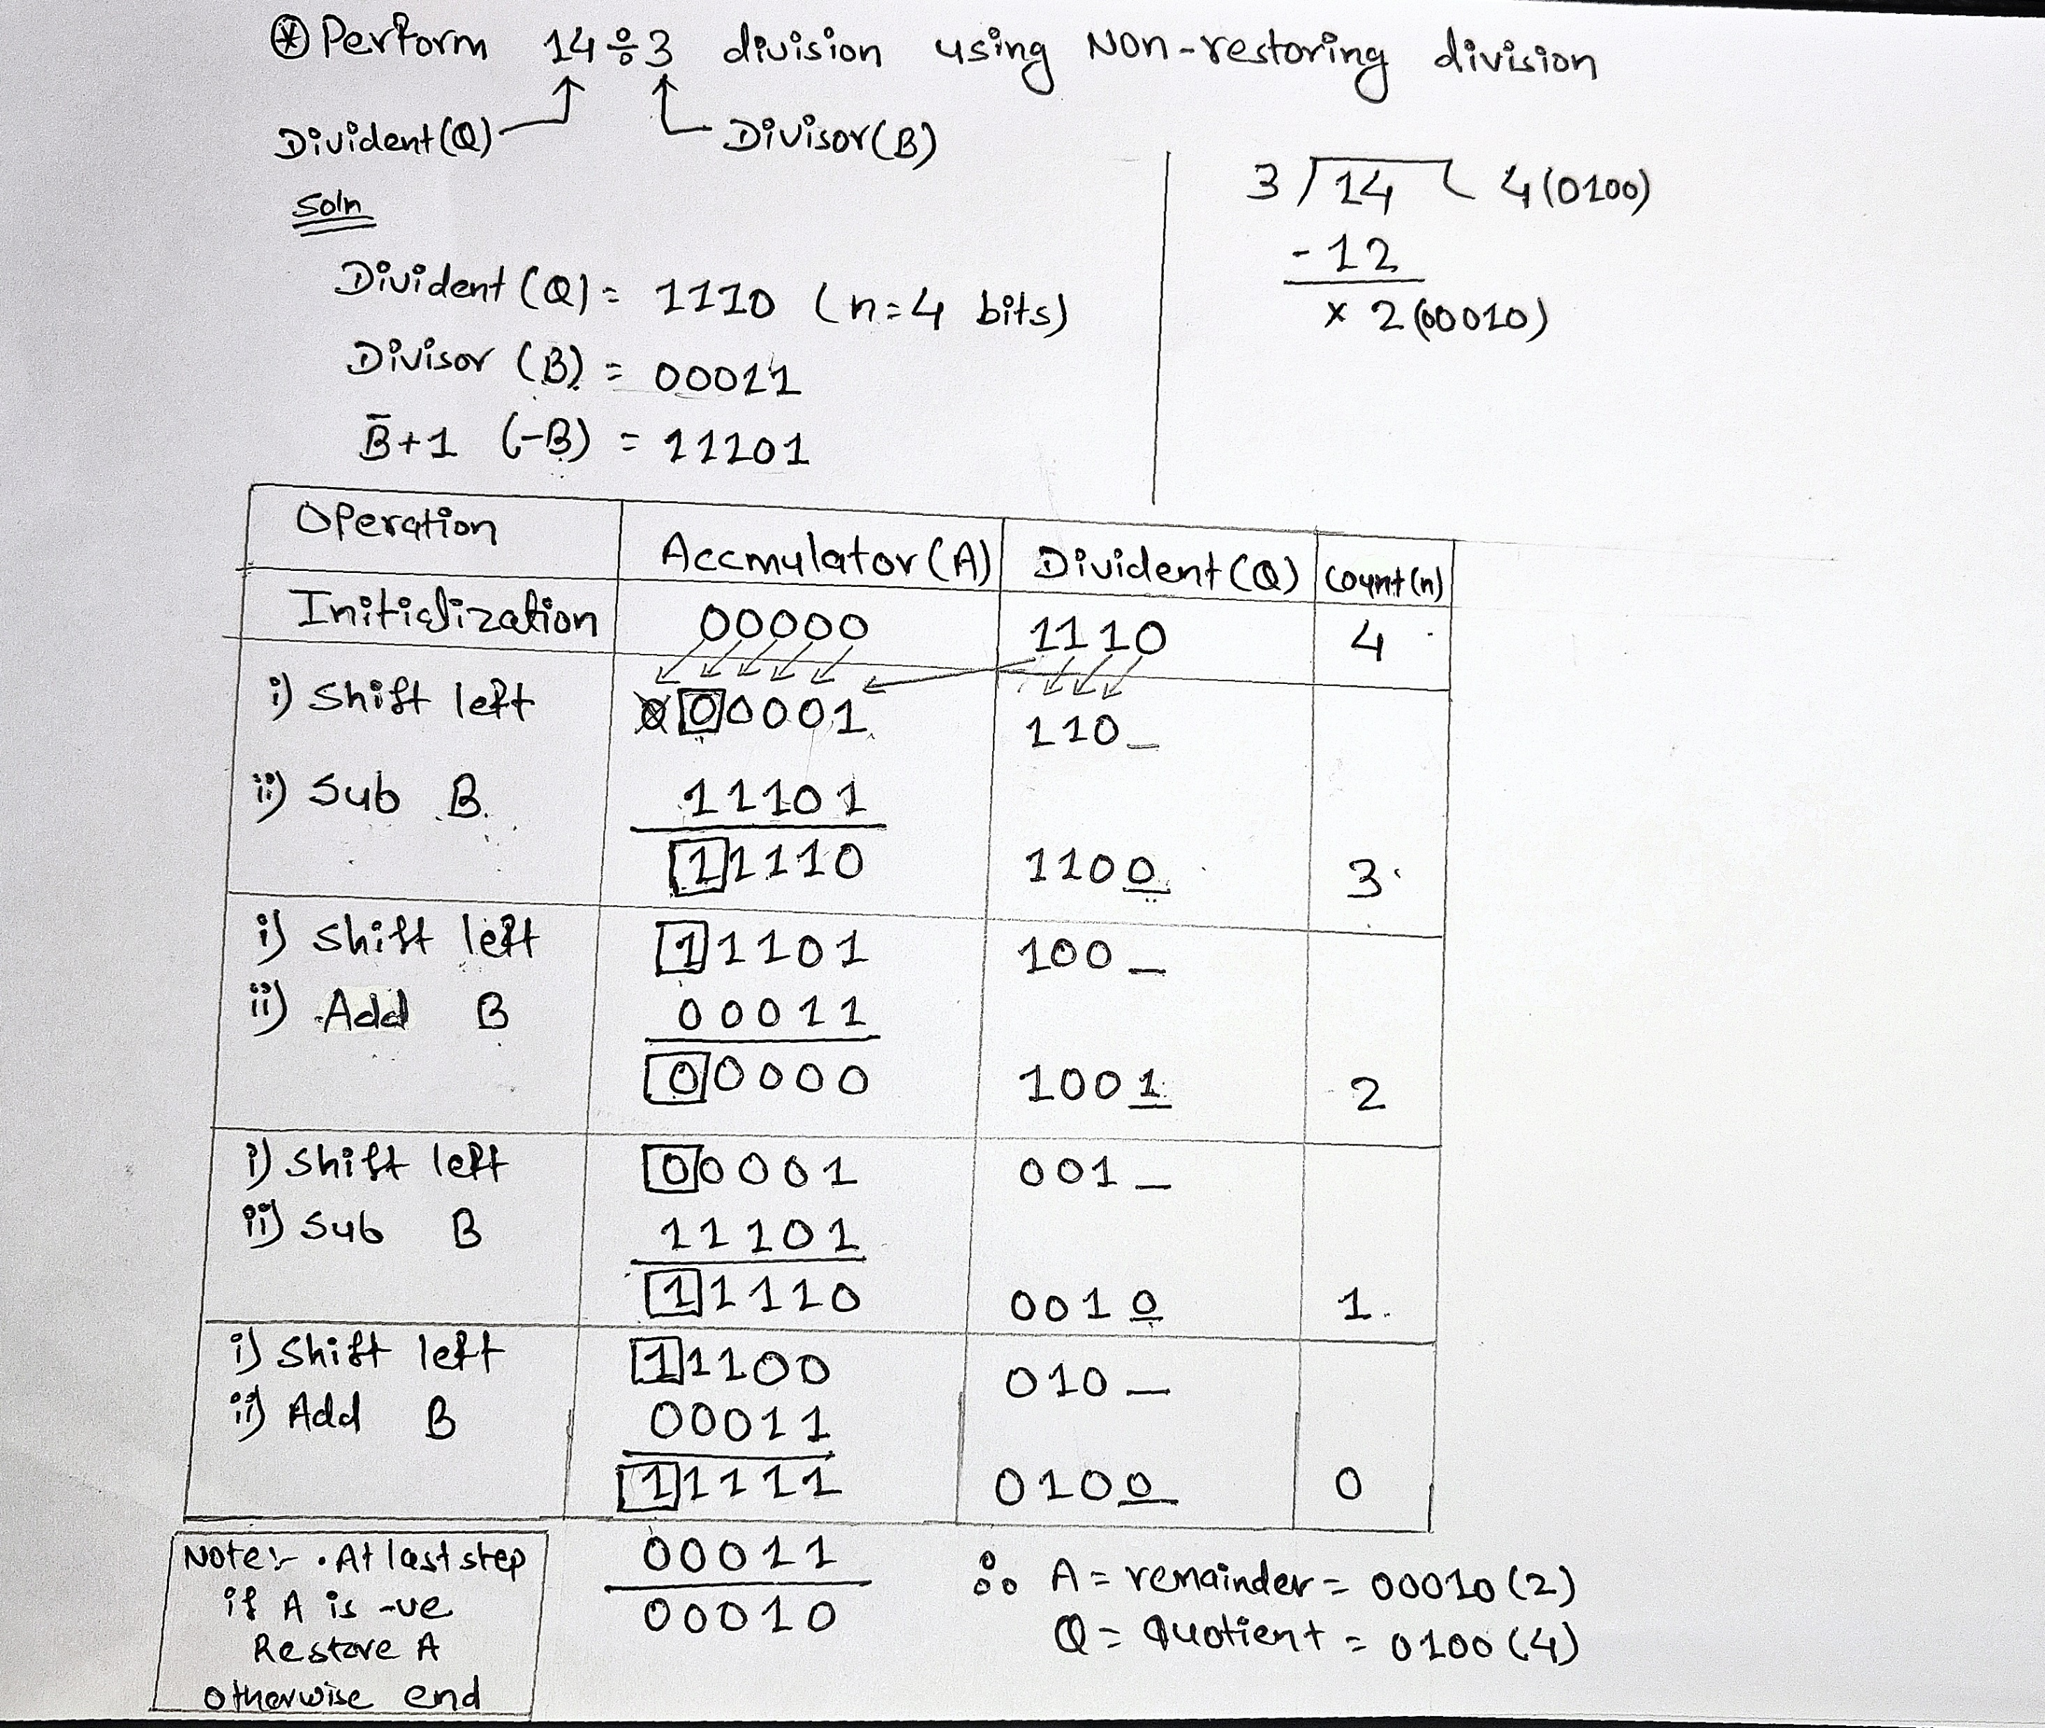
Numerical-Problem:

Slide 5
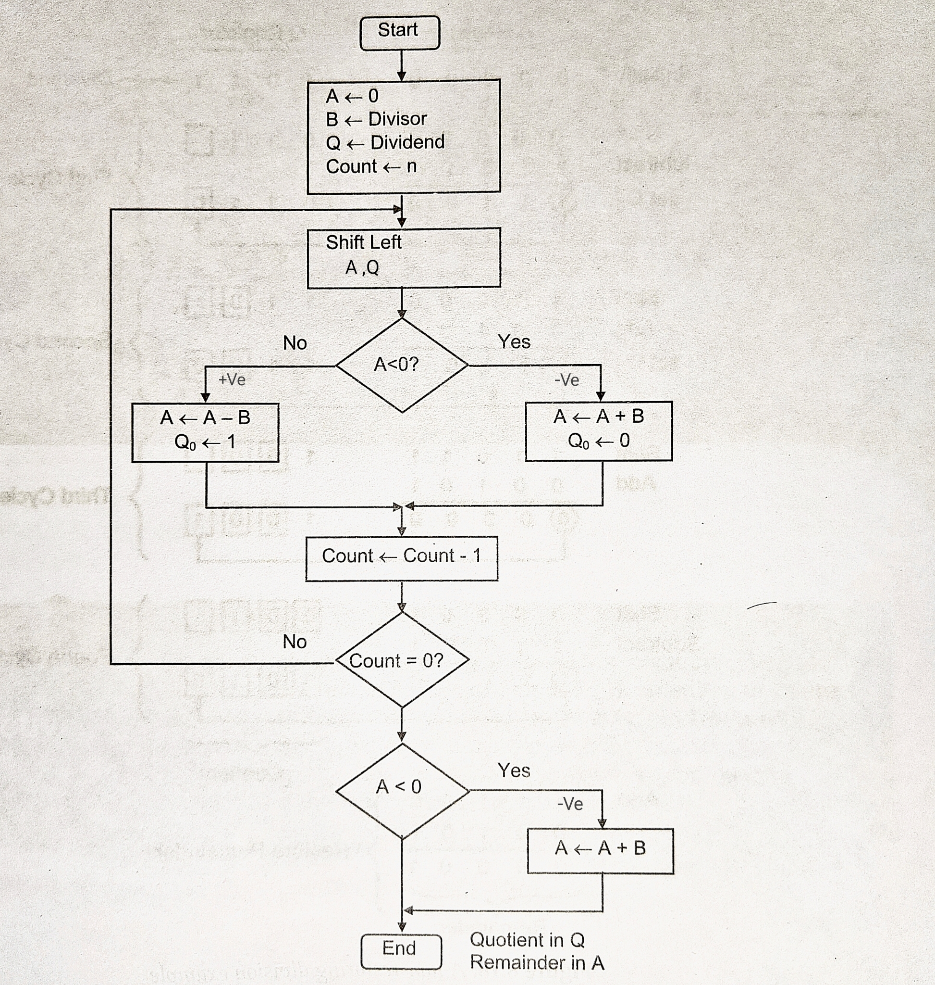
Non-Restroing Division(Flowchat):

Slide 6
THANK YOU

